Slide 1
LTER Ocean Acidification Data Management
LOAD’M
Lydia Kapsenberg (Grad Student)
Santa Barbara Coastal LTER
&
Gastil (Information Manager)
Moorea Coral Reef LTER
LTER ASM 2012
Notes:
Who went to March 2012 OA data mgmt workshop in Seattle (NOAA, IOOS, NANOOS)

Slide 2
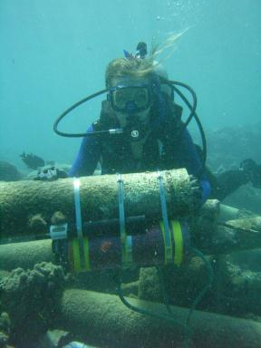
Ocean Acidification Research
Increased efforts → new data sets
Moorea Coral Reef & Santa Barbara Coastal LTERs
Monitoring (SeaFETs)
Biological experiments
EARLY STAGES:
Unique opportunity construct data management plan, a priori
Information Managers and Scientists
SeaFET (E. Rivest)
Notes:
IMs will not be as well versed in CO2 chem as scientists, but they can pick from lists !

Slide 3
Goal: LOAD’M Plan
Ensure accessibility/discoverability and compatibility of OA data across LTER sites in order to share and compile data.
-Core Research Area
-Key Words
-Vocabulary for Measurement Characteristics/Attribute Standardization

Slide 4
Benefits: LOAD’M Plan
Opportunity to agree on vocabulary TODAY
PI’s and grad students can refer to LOAD’M plan in research proposals
Set precedent for fluid data sharing/ standardization within LTER Network Information System
-not making a separate database
Data sharing EPOCA, IOOS, NOAA, BCO-DMO

Slide 5
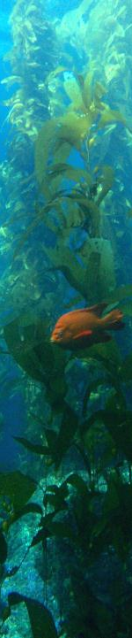
OA Research
Data Management and Sharing
Field Studies
Laboratory Studies
-pH monitoring
-Discrete samples
-Biological exp.
-Artificial OA
SBC LTER

Slide 6
OA Research
Data Management and Sharing
Field Studies
Laboratory Studies
-pH monitoring
-Discrete samples
-Biological exp.
-Artificial OA
Seawater Carbonate Chemistry
SBC LTER

Slide 7
LOAD’M Workshop
Core Research Area (5 min)
Key words (20 min)
Data processing levels (10 min)
Measurement Vocabulary (meta data) (30 min)
Discussion

Slide 8
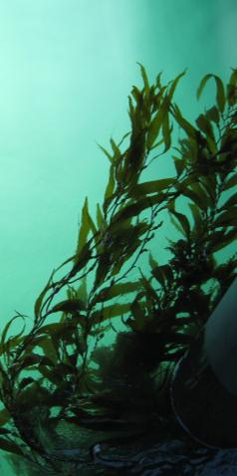
1: Core Research Area
Primary Production
Population Studies
Movement of Organic Matter
Movement of Inorganic Matter
Disturbance Patterns
5

Slide 9
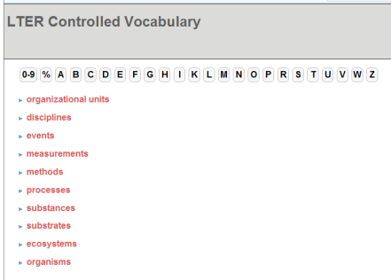
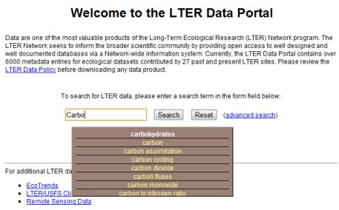
2: Key Words
Data catalog browsing, searching
Scientist: what do you expect to be able to find?
http://vocab.lternet.edu/vocab/vocab/
https://metacat.lternet.edu/das/lter/
20
Notes:
Gastil forgot to add pH keyword to MCR data sets so none were found!
Put in Ocean Acidification – only found 10 data sets from MCR

Slide 10
2: Key Word examples
Ocean acidification
pCO2 vs. partial pressure carbon dioxide
TA vs. total alkalinity?
Omega vs. saturation state; aragonite & calcite
…
*Can be measurements, concepts, instruments, methods…whatever you would google!
Notes:
Not talking about units !
Break into groups – one person presents key words, Gastil takes notes on the paper

Slide 11
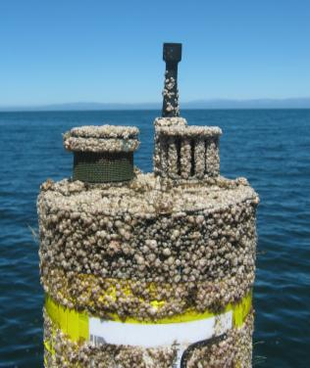
3: Data Levels
Sensor Data
Level 0: raw .dat files?
Level 1: calibrated?
Level 2: clipped and flagged?
Level 3: aggregated, smoothed
10

Slide 12
4: Measurement Vocabulary/ Meta data
Measurements: label (graph), name (for R), abbreviations, definitions, synonyms, variations (ex. pH_{total} vs. pH_{NBS})
Calculated vs. Measured
Ex. pH at 25C vs in situ temperature
Methods (SOPs, software)
Instruments (SeaFET, SeapHox, IPHATs, etc.)
ACTIVITY
-What do you expect to store/archive
-Everything you want to know about someone else’s data set
30

Slide 13
5: Discussion
Consensus on units (ex. pCO2 in dbar vs µatm)
LOAD’M citation: PDF, webpage on IM site
Future work?
Notes:
IMs will synthesize info, Do scientists have any other guidance for IMs? Clarifications?
Tie individual LTERs names to an agreed set, or should we just agree on a complete set?

Slide 14
Resources:
Workshops
OA data management workshop March 15, 2012, Seattle
Manuals Dickson's lab's manuals online http://cdiac.ornl.gov/oceans/Handbook_2007.html EPOCA book download pdf of book
Software CO2SYS http://cdiac.ornl.gov/ftp/co2sys/
CO2calc http://soundwaves.usgs.gov/2011/03/research4.html
seacarb
http://cran.r-project.org/web/packages/seacarb/index.html
http://www.obs-vlfr.fr/~gattuso/seacarb.php

